Slide 1
Economic Policy Uncertainty in China Since 1949: The View from Mainland Newspapers Steven J. Davis, Dingqian Liu and Xuguang S. Sheng
July 16, 2020

Slide 2
Motivation
Uncertainty is the subjective, forward-looking expectation of the future (not sure when will the pandemic be over).
Economic Policy Uncertainty (EPU) captures the common uncertainty in economic activities, that is related to government policy (if the government will shut down cities again).
Facing with uncertainty, consumers and firms choose to wait-and-see, which exaggerate the drop of economic activities (unemployment rate rise, investment shrinks)
To analyze the impact of EPU, we need a measurement.
Challenges:
Low frequency data of macroeconomic activities
Subjective expectation

Slide 3
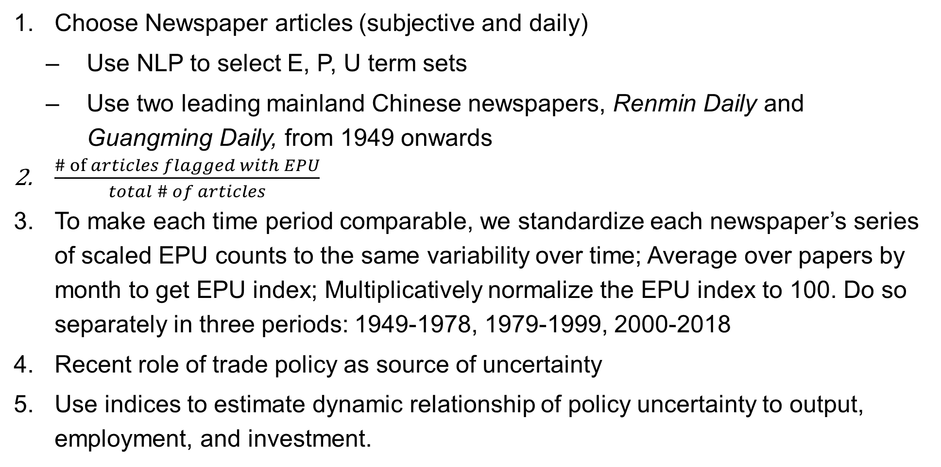
Mechanics of EPU Index Construction
Choose Newspaper articles (subjective and daily)
Use NLP to select E, P, U term sets
Use two leading mainland Chinese newspapers, Renmin Daily and Guangming Daily, from 1949 onwards
$\frac{\# of articles flagged with EPU}{total \# of articles}$
To make each time period comparable, we standardize each newspaper’s series of scaled EPU counts to the same variability over time; Average over papers by month to get EPU index; Multiplicatively normalize the EPU index to 100. Do so separately in three periods: 1949-1978, 1979-1999, 2000-2018
Recent role of trade policy as source of uncertainty
Use indices to estimate dynamic relationship of policy uncertainty to output, employment, and investment.

Slide 4
Economic Policy Uncertainty in China: Globalization Era, January 2000 to September 2019

